Slide 1
Heart Attacks and EMS
Andrew Rosenblum

Slide 2
Overview
Cardiac Anatomy Review
Acute Coronary Syndrome
STEMIs

Slide 3
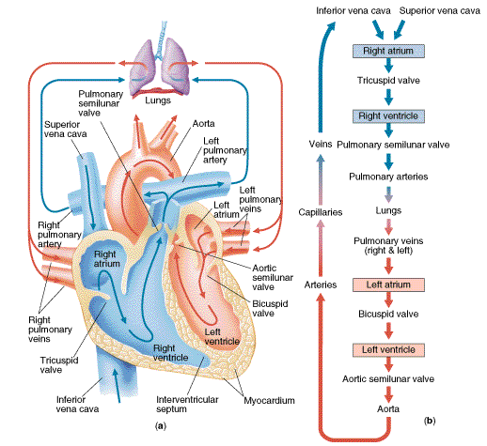
Parts of the Heart
Notes:
Take aways:
Right side of the heart supplies the lungs
Left side supplies the rest of the body

Slide 4
Major Parts of the Heart
4 Chambers
Right side responsible for pumping blood to the lungs
Left side responsible for pumping blood to the rest of the body
Major Vessels
Right coronary artery
Left coronary artery
Circumflex artery
Left anterior descending artery

Slide 5
Major Arteries & Blood Supply
Right Coronary Artery
Right atrium, right ventricle, and the inferior side of the left ventricle and the posterior side of left ventricle for about 85% of the population, among other parts Left coronary artery
Left Coronary Artery divides into:
Circumflex Artery
left atrium, lateral wall of the left ventricle, and the inferior side of the left ventricle and the posterior side of left ventricle for the remaining 15% of the population
Left Anterior Descending Artery
Anterior wall of the left ventricle and some of the lateral wall of the left ventricle

Slide 6
Natural Pacemakers
Sinus Atrial
Intrinsic rate of 60 – 100
Upper posterior right atrium
Atrioventricular Node (AV Node)
Intrinsic rate of 40 – 60
Floor of the right atrium behind the tricuspid valve
Bundle of His/Purkinje Fibers
Intrinsic rate of 20 – 40
Ventricular myocardium
Notes:
SA & AV are above supraventricular vs. bundle of His and below are ventricular

Slide 7
Acute Coronary Syndrome (ACS)
Atherosclerosis forms around the walls of major arteries
Coronary Artery Disease: >50% of the diameter of the artery is restricted
Leads to transient or permanent blockages in the flow of blood
If the tissues become sufficiently cut off from the blood flow it dies -> Acute Myocardial Infarction (AMI)

Slide 8
AMI Signs and Symptoms
Chest discomfort that may radiate to the arm, shoulders, jaw, or back
Generally described as a crushing pain or toothache
May be accompanied by shortness of breath, sweating, nausea, or vomiting.
Source: MIEMSS 2016 Protocols

Slide 9
OPQRST
Onset: When did it start? What was going on?
Provocation: anything make it better or worst?
Quality: describe it?
Radiation: moving anywhere?
Severity: 1-10
Time: how long? Changes over time?

Slide 10
Physical Exam
Reproducible
Lung sounds
Trauma

Slide 11
AMIs & EKGs
The hypoxic part of the heart is dying, leading to EKG changes
The hallmark change is ST Segment Elevation leading to the name:
ST Segment Elevated Myocardial Infarction (STEMI)

Slide 12
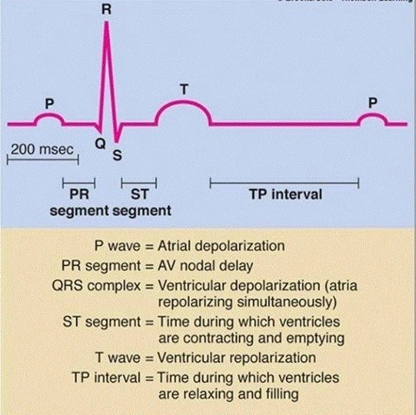

Slide 13
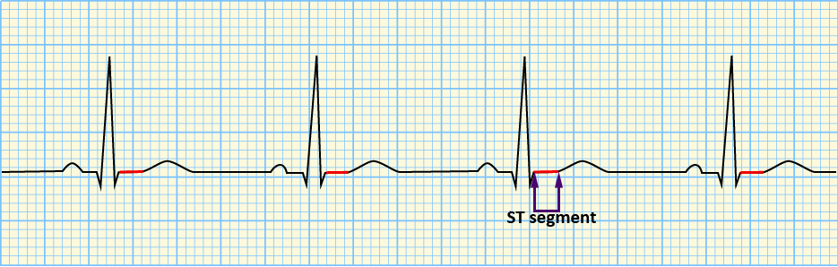
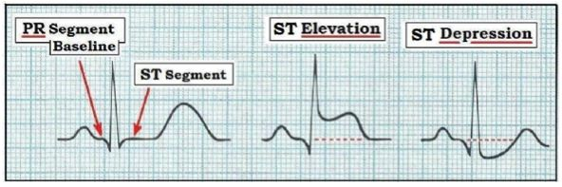
ST segment Elevated Myocardial Infarction (STEMI)
Source: http://healthtipsinsurance.com/pics/26/ST-Depression-May-Represent-Myocardial-Ischaemia----ST-Elevation-May-Represent-Myocardial-Infarction.jpg
https://learningcentral.health.unm.edu/learning/user/onlineaccess/CE/intro_baci_online/interpret/img/comp_st.png

Slide 14
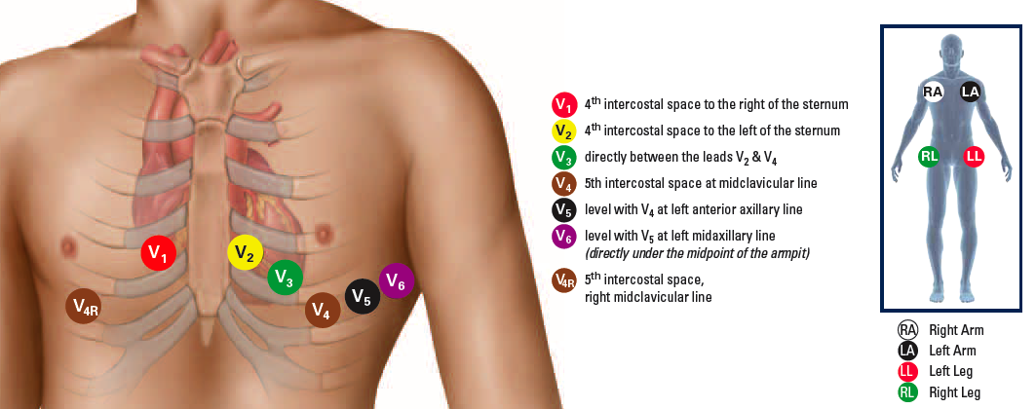
12 Lead EKGs
Source: http://www.statmedicaleducation.com/wp-content/uploads/2014/03/EMS-Chest-L.png

Slide 15
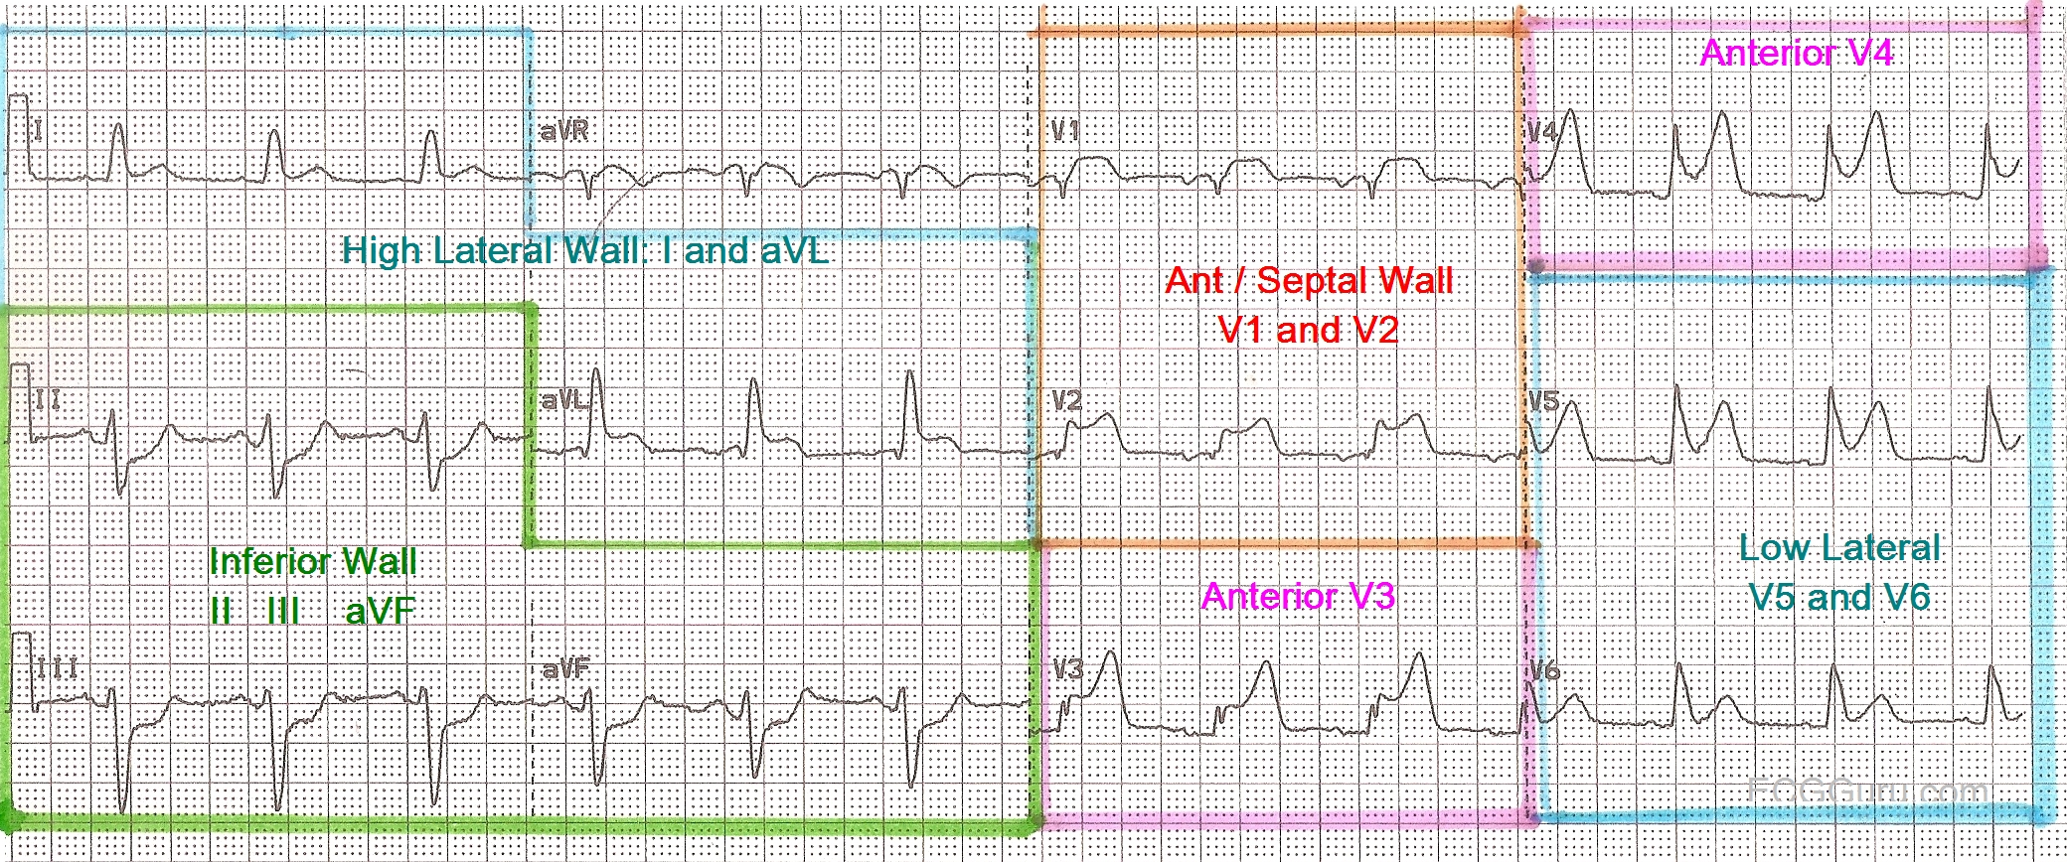
12 Lead EKGs
Source:https://www.ecgguru.com/sites/default/files/resource-docs/Mapped%20ECG_0.jpg

Slide 16
BLS 12 Lead EKGs
AHA recommends a 12 lead be obtained with 10 minutes of patient contact
BLS providers can obtain 12 leads
Adds an average 5.9 minutes
Then rely on online physician interpretation or the monitor’s algorithm
EKG monitors have been shown to have a 74% PPV and 98.1% NPV

Slide 17
Prehospital Treatment
M – Morphine
O – Oxygen
N – Nitroglycerin
A – Aspirin

Slide 18
Aspirin
Platelet inhibitor
Standard Dose 324 or 325mg
Contraindications: allergic
Be careful with GI bleeding
Chew it:
5 minutes to reach the blood vs. 12 for swallowing

Slide 19
Nitroglycerin
Dose 0.4mg sublingual
BLS: Patient Assisted Medication q 3-5 min, max 3 doses (patient and EMS)
ALS: same as above. Must have an IV if pt is not prescribed NTG
SBP must be > 90 mmHg; No drop of more than 20 mmHg & Pulse > 60 BPM
No recent pulmonary hypertensive or sexually enhancing medications within 48 hours
Half life is 1-4 minutes; Effects expected within 1-2 minutes

Slide 20
Oxygen
Only provide oxygen when indicated
SpO2 < 94%
AHA: “there is insufficient evidence to support routine use of oxygen in uncomplicated ACS without signs of hypoxemia or heart failure or both”
RCT of oxygen in STEMI found no improvement in pain and worst outcomes at 6 months

Slide 21
Morphine (and Fentanyl)
Additionally pain management
Morphine:
0.1 mg/kg IV or IM
max single dose of 20mg with 10mg repeat dose allowed
Fentanyl:
1 mcg/kg IV or IN or IM
Max single dose of 200 mcg with a repeat dose of 200 mcg max

Slide 22
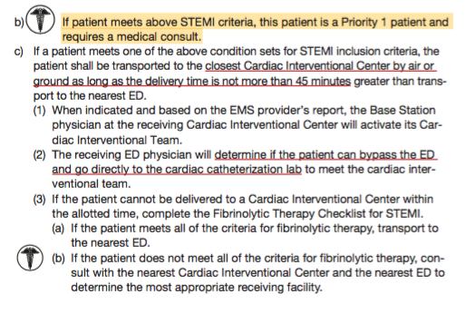
Definitive Care
Source: 2016 Maryland EMS Protocols

Slide 23
Definitive Care
Fibro
PCI
Video?

Slide 24
Sources
Aehlert B. ECGs Made Easy. Fifth Edition ed. St. Louis, Missouri: Elsevier Mosby; 2013.
Draft 4 – 15-17; 10; 22;

Slide 25
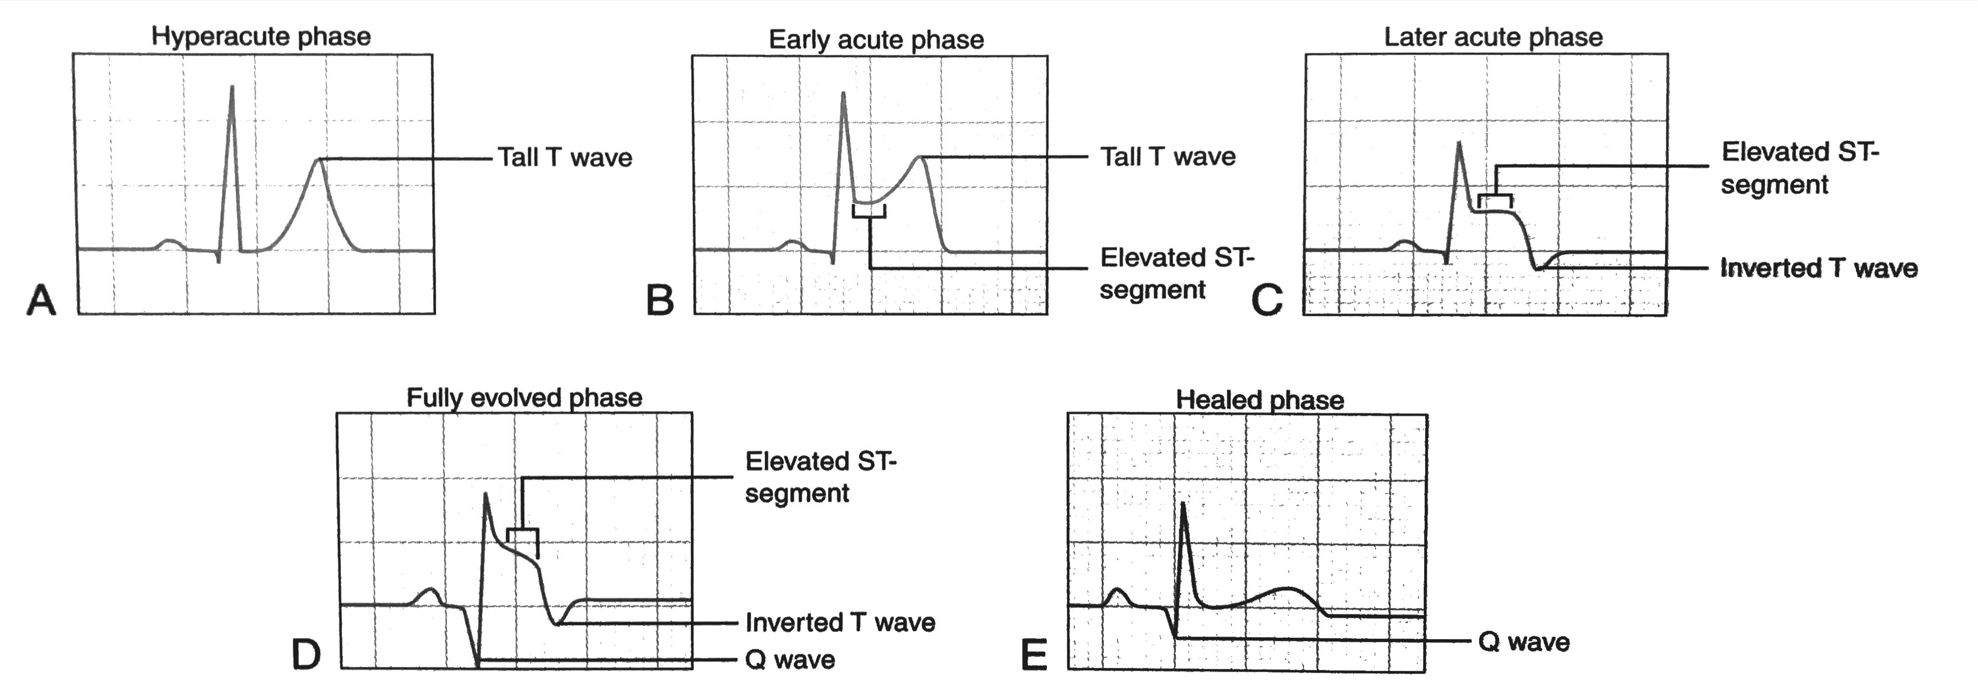
Source: Progression of a STEMI over a period of hours. Source: Aehlert B. ECGs Made Easy. Fifth Edition ed. St. Louis, Missouri: Elsevier Mosby; 2013.

Slide 26
Other Causes of Chest Pain
AAA
Percarditis
PE
Trauma
Seatbelts, punches, etc.

Slide 27
Electrical Activity
Formation of electrical impluses
Heart fibers depolarizing
Nerves that fire

Slide 28
Pacemakers
Sinus Atrial
Intrinsic rate of 60 – 100
Upper posterior right atrium
Atrioventricular Node (AV Node)
Intrinsic rate of 40 – 60
Floor of the right atrium behind the tricuspid valve
Bundle of His/Purkinje Fibers
Intrinsic rate of 20 – 40
Ventricular myocardium
Notes:
SA & AV are above supraventricular vs. bundle of His and below are ventricular

Slide 29
EKG
Provides information on:
Conduction
Lead II provides the best view from top to

Slide 30
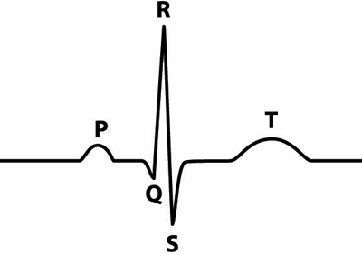

Slide 31
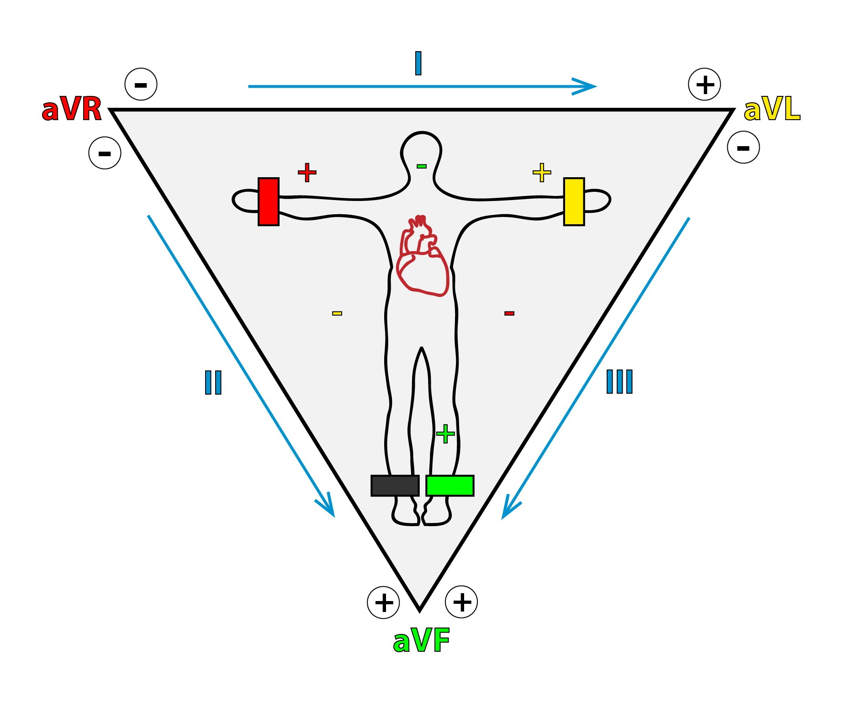
Standard Limb Leads
I [L arm (+) → R arm (-)]
II [L leg (+) → R arm (-)]
III [L leg (+) → l arm (-)]
But they’re bipolar”
aVr[R arm (+)]
aVL[L arm (+)]
aVF[L leg (+)]
Notes:
Measuring the difference in electrical potential between A & B
Augmented are in reference to a central terminal (effectively 0)
Value of lead II

Slide 32
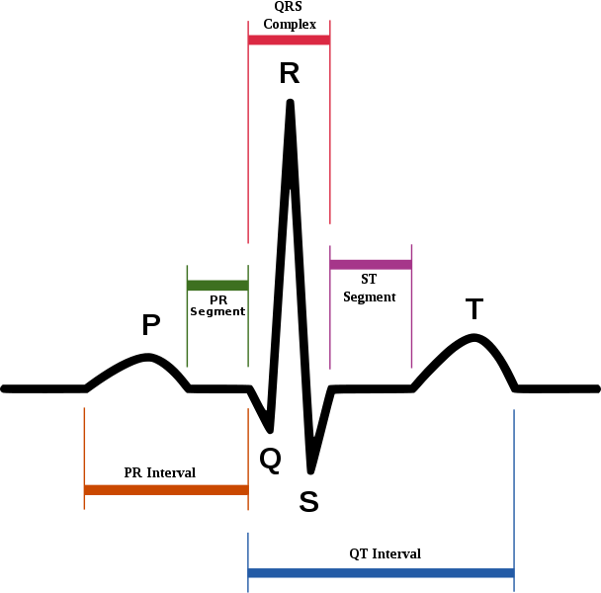
Intervals

Slide 33
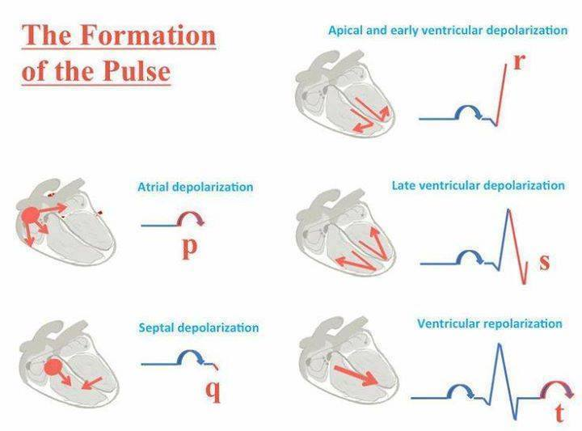

Slide 34
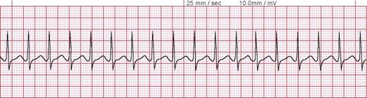
Where is this rhythm coming from?
Supraventricular tachycardia (SVT)
Source: http://www.medicine-on-line.com/html/ecg/e0001en_files/image104.png

Slide 35
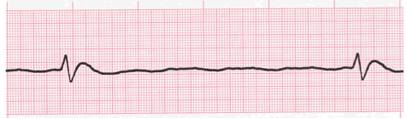
Where is this rhythm coming from?
Idioventricular rhythm
Source: https://ekg.academy/ecgLessons/ventricularAssets/v111.gif

Slide 36
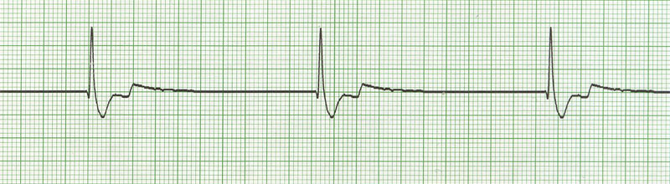
Where is this rhythm coming from?
Junctional rhythm
Source: http://highered.mheducation.com/sites/dl/free/0073520713/356821/chap10_5.jpg

Slide 37
Where is this rhythm coming from?
Idioventricular rhythm
Source: https://ekg.academy/ecgLessons/ventricularAssets/v111.gif

Slide 38
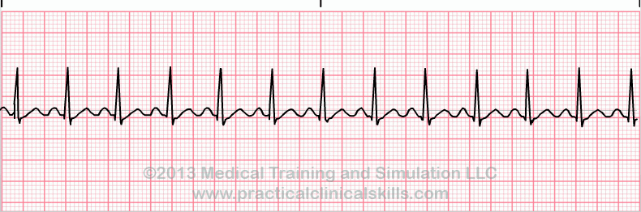
Where is this rhythm coming from?
Sinus tachycardia
https://s3.amazonaws.com/classconnection/925/flashcards/1513925/gif/31-1502F2E36760A004AD7.gif

Slide 39
EKG Abnormalities

Slide 40
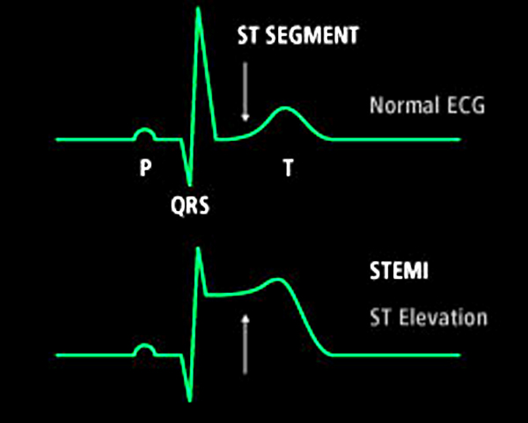
STEMI

Slide 42
12 Lead

Slide 44
https://circulatorysystemlesson.wikispaces.com/file/view/BloodFlowPhysiology.gif/84430933/BloodFlowPhysiology.gif
http://www.todayifoundout.com/wp-content/uploads/2011/10/ekg.png
http://ekg.academy/images/ekg-componentNames3.gif
http://fblt.cz/wp-content/uploads/2013/12/Kapitola-10-01-ENG-05.jpg

